Slide 1
Cache Memory

Slide 2
Introduction
In our library example, the desk acted as a cache—a safe place to store things(books) that we needed to examine.
Cache memory is the top level of the memory hierarchy, which is in between the processor and main memory.
The memories in the datapath are simply replaced by caches.

Slide 3
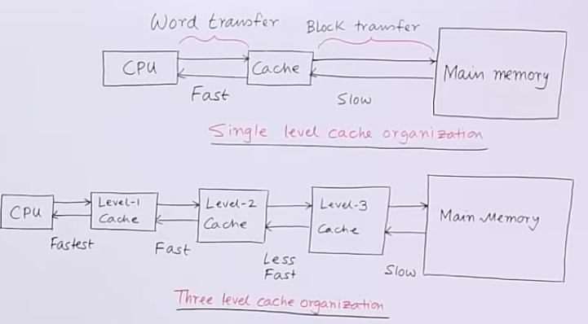

Slide 4
Accessing a Cache
There are three types of mapping a data from main memory to catch memory.
Direct mapping
Associative mapping
Set associative mapping
Mapping refers to copying the content of a location in main memory to a location in the catch memory.

Slide 5
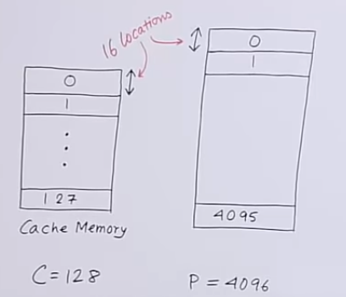
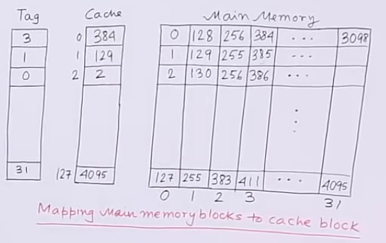

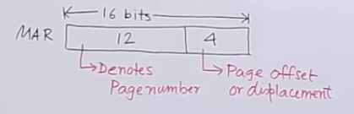
Example.
Note: Frame size = page size
Direct Mapping

Slide 6
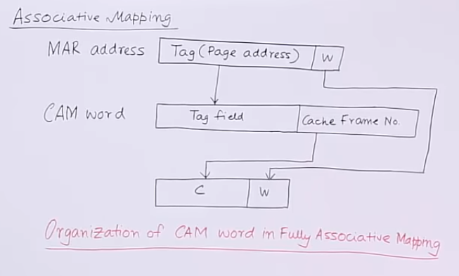
Associative Mapping

Slide 7
